Slide 1
Digital Bone Box
Brian Elliott, M.S.
Yun Tan, M.D., Ph.D.
SKULL

Slide 2
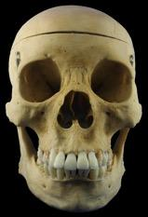
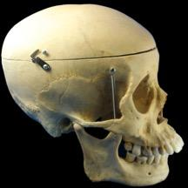
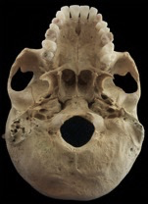
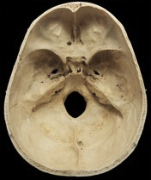
Skull
Skull
Anterior
Lateral
Inferior (base)
Superior (cavity)
Anterior view
Lateral view
Inferior view (cranial base)
Superior view
(cranial cavity)
Home

Slide 3
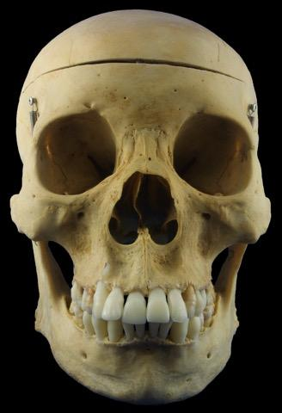
Skull
Skull
Anterior
Lateral
Inferior (base)
Superior (cavity)
Frontal bone
Sphenoid bone
Nasal bone
Zygomatic bone
Maxilla
Mandible
Frontal bone
Glabella
Parietal bone
Supraorbital foramen
Sphenoid bone
Lesser wing
Greater wing
Nasal bone
Zygomatic bone
Anterior view
The anterior view is generally ovoid in shape.
The forehead is superior to the orbit and is formed by the frontal bone.
The bones that make up the borders of the orbit are the frontal bone superiorly, medially, and laterally, the zygomatic bone laterally and inferiorly, and the maxilla inferior and medially.
The anterior nasal opening is formed by the nasal and maxilla bones.
The maxilla contributes to the upper jaw, while the lower jaw is formed by the mandible.
Frontal process
Zygomaticofacial foramen
Maxilla
Temporal process
Frontal process
Zygomatic process
Infraorbital foramen
Alveolar process
Mandible
Ramus
Body
Mental foramen
Mental protuberance
Anterior view
Home
No labels

Slide 4
Skull
Skull
Anterior
Lateral
Inferior (base)
Superior (cavity)
Frontal bone
Sphenoid bone
Nasal bone
Zygomatic bone
Maxilla
Mandible
Anterior view
Home
Labels

Slide 5
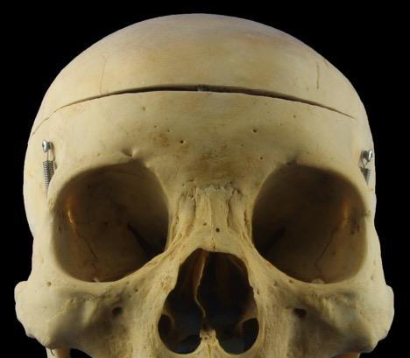
Skull
Skull
Anterior
Lateral
Inferior (base)
Superior (cavity)
Frontal bone
Sphenoid bone
Nasal bone
Zygomatic bone
Maxilla
Mandible
Superciliary arches
Supraorbital foramen
Frontal bone
Glabella
A slight depression that lies between the two superciliary arches..
It can be more pronounced in males.
Supraorbital foramen (notch)
An opening at the superior rim of the orbit that transmits the supraorbital nerve and vessels.
Nasion
Lies at the junction where the frontal bone meets the nasal bones.
Zygomatic process
The lateral part of the bone that extends inferiorly to join with the zygomatic bone.
Forms part of the lateral border of the orbit.
Nasion
Glabella
Zygomatic process
Anterior view
Home
Labels

Slide 6
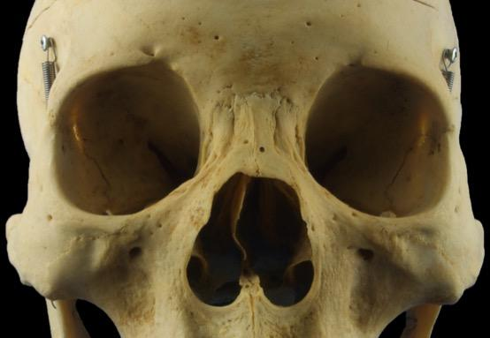
Skull
Skull
Anterior
Lateral
Inferior (base)
Superior (cavity)
Frontal bone
Sphenoid bone
Nasal bone
Zygomatic bone
Maxilla
Mandible
Superior orbital fissure
Optic canal
Lesser wing
Greater wing
Sphenoid bone
Anteriorly, the sphenoid bone can be seen in the deep part of the orbit.
Superior orbital fissure
A gap formed by the lesser and greater wings of the sphenoid bone.
Transmits the oculomotor nerve (CN III), trochlear nerve (CN IV), branches of the ophthalmic nerve (CN V₁), abducent nerve (CN VI), and the superior ophthalmic vein.
Optic canal
Located in the sphenoid bone.
Transmits the optic nerve and the ophthalmic artery.
Anterior view
Home
Labels

Slide 7
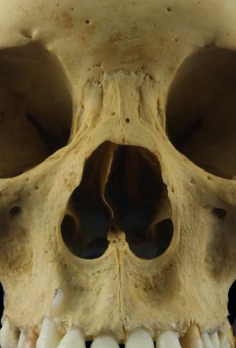
Skull
Skull
Anterior
Lateral
Inferior (base)
Superior (cavity)
Frontal bone
Sphenoid bone
Nasal bone
Zygomatic bone
Maxilla
Mandible
Nasal bone
Two small, oblong shaped bones that form the “bridge” of the nose.
Anterior view
Home
Labels

Slide 8
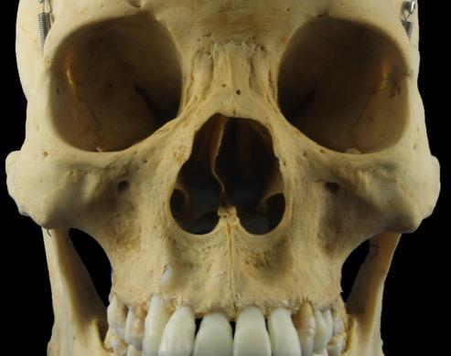
Skull
Skull
Anterior
Lateral
Inferior (base)
Superior (cavity)
Frontal bone
Sphenoid bone
Nasal bone
Zygomatic bone
Maxilla
Mandible
Frontal process
Zygomatic bone
An irregular shaped bone that, together with the maxilla, forms the “cheek” bones.
Frontal process
The portion of bone that extends superiorly to join with the frontal bone.
Contributes to the lateral border of the orbit.
Zygomaticofacial foramen
A small opening just inferior and lateral to the orbit.
Transmits the zygomaticofacial nerve and vessels.
Temporal process
The portion of bone that extends laterally and posteriorly to join the temporal bone.
Forms part of the zygomatic arch.
Zygomaticofacial foramen
Temporal process
Anterior view
Home
Labels

Slide 9
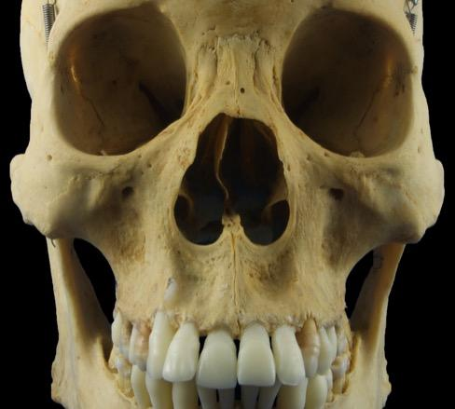
Skull
Skull
Anterior
Lateral
Inferior (base)
Superior (cavity)
Frontal bone
Sphenoid bone
Nasal bone
Zygomatic bone
Maxilla
Mandible
Frontal process
Infraorbital foramen
Maxilla
Two bones that make up the central part of the face and upper jaw.
Frontal process
Part of the bone that extends superiorly to join the frontal and nasal bones.
Infraorbital foramen
A small opening just inferior to the inferior orbit rim.
Transmits the infraorbital nerve and vessels.
Zygomatic process
Part of the bone that extends laterally to meet with the zygomatic bone.
Alveolar process
Part of bone that extends inferiorly and forms upper jaw.
Contains the upper teeth.
Zygomatic process
Alveolar process
Anterior view
Home
Labels

Slide 10
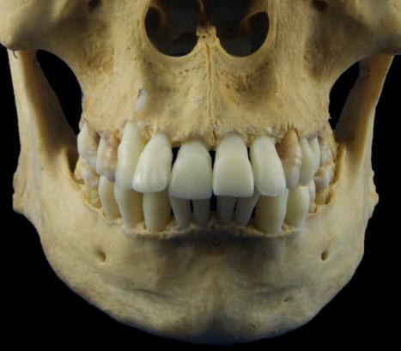
Skull
Skull
Anterior
Lateral
Inferior (base)
Superior (cavity)
Frontal bone
Sphenoid bone
Nasal bone
Zygomatic bone
Maxilla
Mandible
Ramus
Mandible
Bone that forms the lower jaw and contains the lower teeth.
Body
Horizontal part the bone that fuses with the bone from the opposite side during development.
Ramus
Part of bone that projects superiorly from the posterior part of the body.
Mental foramen
An opening in the body of the mandible that lies in the same sagittal plane as the supraorbital and infraorbital foramina.
Transmits the mental nerve and vessels.
Mental protuberance
Part of bone that slightly extends anteriorly.
The mental tubercles on each side produce the characteristic prominence of the chin.
Body
Mental foramen
Mental protuberance
Mental tubercle
Anterior view
Home
Labels

Slide 11
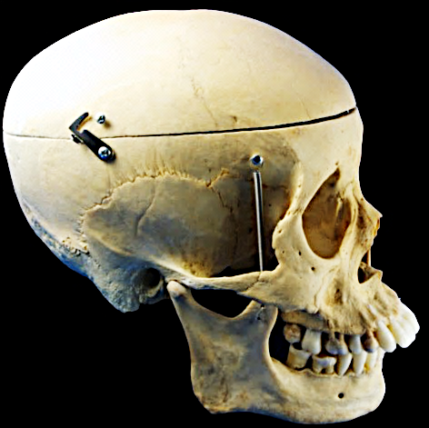
Skull
Skull
Anterior
Lateral
Inferior (base)
Superior (cavity)
Coronal suture
Parietal bone
Sphenoid bone
Ethmoid bone
Lacrimal bone
Temporal bone
Mandible
Temporal fossa
Parietal bone
Frontal bone
Glabella
Supraorbital foramen
Lateral view
The lateral view can be divided into 3 sections:
Facial – anterior
Temporal – middle
Occipital – posterior
The temporal section is separated by the zygomatic arch into into a temporal fossa superiorly and an infratemporal fossa inferiorly.
The origin of the temporalis muscle attaches to the temporal fossa
The pterion is located in the temporal fossa and marks the junction where the frontal, parietal, temporal, and sphenoid bones meet.
The pterion is an important landmark because it overlies the anterior branch of the middle meningeal artery.
Damage to this area of the skull can cause a rupture of this artery
Pterion
Sphenoid bone
Ethmoid bone
Greater wing
Nasal bone
Occipital bone
Lacrimal bone
Temporal bone
Zygomatic process
External acoustic meatus
Maxilla
Mastoid process
Mandible
Head of condylar process
Mandibular notch
Coronoid process
Ramus
Body
Mental foramen
Lateral view (right aspect)
Home
No labels

Slide 12
Skull
Skull
Anterior
Lateral
Inferior (base)
Superior (cavity)
Parietal bone
Sphenoid bone
Ethmoid bone
Lacrimal bone
Temporal bone
Mandible
Lateral view (right aspect)
Home
Labels

Slide 13
Skull
Skull
Anterior
Lateral
Inferior (base)
Superior (cavity)
Parietal bone
Sphenoid bone
Ethmoid bone
Lacrimal bone
Temporal bone
Mandible
Parietal bone
Makes up the large, curved portion superior, lateral and posterior skull.
Joins with the posterior part of the frontal bone at the coronal suture.
Joins with the superior part of the occipital bone at the lambdoid suture.
Lateral view (right aspect)
Home
Labels

Slide 14
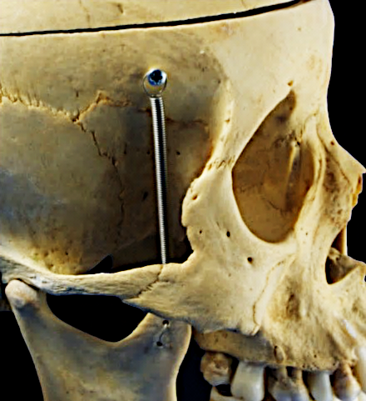
Skull
Skull
Anterior
Lateral
Inferior (base)
Superior (cavity)
Parietal bone
Sphenoid bone
Ethmoid bone
Lacrimal bone
Temporal bone
Mandible
Sphenoid bone
The greater wing of the sphenoid bone can be seen from the lateral view.
The greater wing forms part of the medial wall of the temporal fossa and the roof of the infratemporal fossa.
Lateral view (right aspect)
Home
Labels

Slide 15
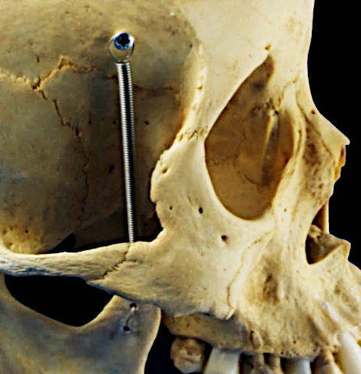
Skull
Skull
Anterior
Lateral
Inferior (base)
Superior (cavity)
Parietal bone
Sphenoid bone
Ethmoid bone
Lacrimal bone
Temporal bone
Mandible
Ethmoid bone
The ethmoid bone forms part of the medial wall of the orbit.
Lateral view (right aspect)
Home
Labels

Slide 16
Skull
Skull
Anterior
Lateral
Inferior (base)
Superior (cavity)
Parietal bone
Sphenoid bone
Ethmoid bone
Lacrimal bone
Temporal bone
Mandible
Frontal process of maxilla
Fossa for lacrimal sac
Lacrimal bone
The lacrimal bone forms part of the medial wall of the orbit.
Fossa for lacrimal sac
A shallow depression formed by the frontal process of the maxilla and the lacrimal bone.
The lacrimal sac is the dilated portion of the nasolacrimal duct and is part of an apparatus to drain tears from the surface of the eye to the inferior nasal meatus.
Lateral view (right aspect)
Home
Labels

Slide 17
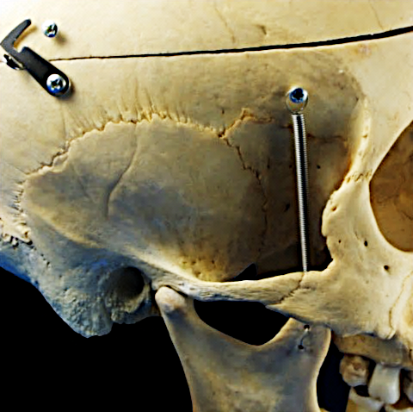
Skull
Skull
Anterior
Lateral
Inferior (base)
Superior (cavity)
Parietal bone
Sphenoid bone
Ethmoid bone
Lacrimal bone
Temporal bone
Mandible
Temporal bone
Squamous part
The flattened part of the temporal bone that makes up much of the floor (medial wall) of the temporal fossa.
Zygomatic process
Part of the bone that extends anteriorly to join with the temporal process of the zygomatic bone.
Together, these form the zygomatic arch.
Mastoid process
An inferior projection where the insertion of the sternocleidomastoid muscle attaches.
External acoustic meatus
The external opening for the ear.
Mandibular fossa
A shallow depression that receives the head of the condylar process of the mandible to form the temporomandibular joint.
Squamous part
Zygomatic process
External acoustic meatus
Mastoid process
Mandibular fossa
Lateral view (right aspect)
Home
Labels

Slide 18
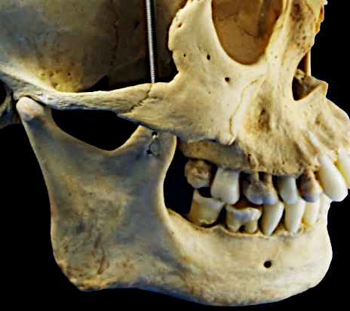
Skull
Skull
Anterior
Lateral
Inferior (base)
Superior (cavity)
Parietal bone
Sphenoid bone
Ethmoid bone
Lacrimal bone
Temporal bone
Mandible
Mandible
Ramus
Is quadrangular in shape and projects superiorly from the posterior part of the body of the mandible.
The insertion of the masseter muscle attaches to the lateral surface of the ramus.
Condylar process
The posterior projection of the ramus.
Distal portion has a head that articulates with the condylar fossa of the temporal bone to form the temporomandibular joint.
Coronoid process
The anterior projection of the ramus.
The temporalis muscle inserts on the coronoid process.
Mandibular notch
Space created by the separation of the two processes of the ramus.
Angle
The part of the bone where the ramus and inferior borders meet.
Head of condylar process
Mandibular notch
Coronoid process
Ramus
Body
Angle
Mental foramen
Lateral view (right aspect)
Home
Labels

Slide 19

Skull
Skull
Anterior
Lateral
Inferior (base)
Superior (cavity)
Maxilla
Sphenoid bone
Palatine bone
Temporal bone
Vomer
Occipital bone
Maxilla
Incisive foramen
Sphenoid bone
Palatine process
Pterygoid process
Zygomatic process
Greater wing
Palatine bone
Foramen ovale
Greater palatine foramen
Foramen spinosum
Lesser palatine foramen
Cranial base
The base of the skull extends from the upper teeth anteriorly to the superior nuchal line of the occipital bone posteriorly.
Temporal bone
Vomer
Zygomatic process
Carotid canal
Occipital bone
Styloid process
Foramen lacerum
Stylomastoid foramen
Basilar part
Mastoid process
Hypoglossal canal
Occipital condyle
Foramen magnum
Jugular foramen
Superior nuchal line
Parietal bone
Inferior view
(cranial base)
Home
No labels

Slide 20
Skull
Skull
Anterior
Lateral
Inferior (base)
Superior (cavity)
Maxilla
Sphenoid bone
Palatine bone
Temporal bone
Vomer
Occipital bone
Inferior view
(cranial base)
Home
Labels

Slide 21
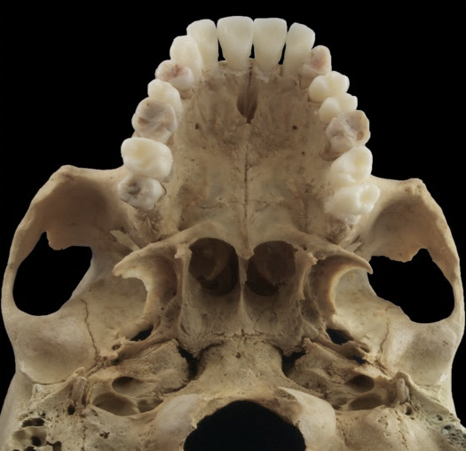
Skull
Skull
Anterior
Lateral
Inferior (base)
Superior (cavity)
Maxilla
Sphenoid bone
Palatine bone
Temporal bone
Vomer
Occipital bone
Transverse palatine suture
Incisive foramen
Zygomatic process
Median palatine suture
Palatine process
Maxilla
Palatine process
The inferior portion of each maxilla that makes up the anterior part of the hard palate.
Median palatine suture
The joint between the palatine processes on each side.
Transverse palatine suture
The joint between the palatine processes of the maxilla and the horizontal plates of the palatine bones.
Incisive foramen
An opening in the midline of the anterior part of the hard palate.
Transmits the nasopalatine nerve and the sphenopalatine vessels.
Inferior view
(cranial base)
Home
Labels

Slide 22
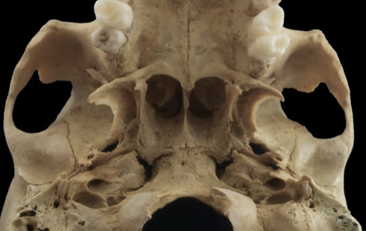
Skull
Skull
Anterior
Lateral
Inferior (base)
Superior (cavity)
Pterygoid process
Maxilla
Sphenoid bone
Palatine bone
Temporal bone
Vomer
Occipital bone
Lateral plate
Hamulus
Pterygoid fossa
Scaphoid fossa
Medial plate
Sphenoid bone
Pterygoid process
Projects inferiorly from the junction of the body and the greater wing of the sphenoid bone.
Composed of medial and lateral pterygoid plates separated by the pterygoid fossae.
The origins of the medial and lateral pterygoid muscles are from either side of the lateral plate respectively.
The tensor veli palatini muscle arises partially from the scaphoid fossa at the base of the medial plate and hooks around the hamulus.
Foramen ovale
An oval opening at the base of the lateral plate.
Transmits the mandibular branch (V₃) of the trigeminal nerve (CN V) as well as the lesser petrosal nerve and the accessory meningeal artery.
Foramen spinosum
A smaller opening just posterior and lateral to the foramen ovale.
Transmits the middle meningeal artery and the meningeal branch of the mandibular nerve
Greater wing
Foramen ovale
Foramen spinosum
Inferior view
(cranial base)
Home
Labels

Slide 23
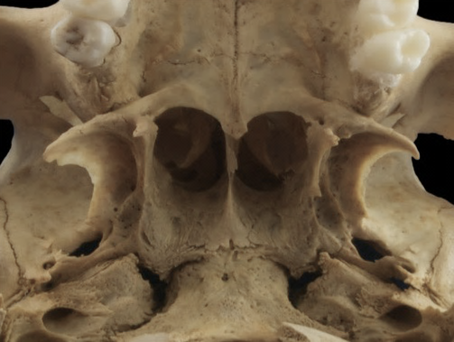
Skull
Skull
Anterior
Lateral
Inferior (base)
Superior (cavity)
Maxilla
Sphenoid bone
Palatine bone
Temporal bone
Vomer
Occipital bone
Horizontal plate
Greater palatine foramen
Lesser palatine foramen
Palatine bone
Horizontal plate
Forms the posterior part of the hard palate.
Greater palatine foramen
An opening just lateral to the third molars of the upper jaw.
Transmits the greater palatine nerve and vessels.
Lesser palatine foramen
A smaller opening that lies posterior to the greater palatine foramen.
Usually found in the pyramid process of palatine bone.
Transmits the lesser palatine nerve and vessels.
Inferior view
(cranial base)
Home
Labels

Slide 24
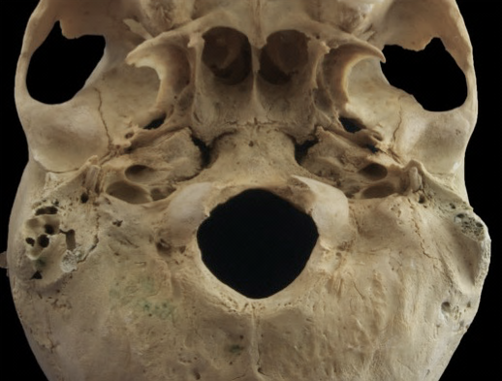
Skull
Skull
Anterior
Lateral
Inferior (base)
Superior (cavity)
Maxilla
Sphenoid bone
Palatine bone
Temporal bone
Vomer
Occipital bone
Zygomatic process
Temporal bone
Petrotympanic fissure
A fissure between the mandibular fossa and the tympanic part of the temporal bone.
Transmits the chorda tympani branch of the facial nerve (CN VII).
Carotid canal
A small opening in the petrous part medial to the styloid process.
Transmits the internal carotid artery and the carotid autonomic plexus.
Styloid process
A sharp protrusion that extends inferiorly and anteriorly from the petrous part.
Three muscles take origin here, they are: styloglossus, stylohyoid, and stylopharyngeus.
Stylomastoid foramen
An opening between the styloid and mastoid processes.
Transmits the facial nerve (CN VII).
Mastoid process
A rounded protrusion that extends inferiorly from the lateral part of the temporal bone just behind the external acoustic meatus.
Serves as an attachment for splenius and longissimus capitus, posterior belly of the digastric, and the sternocleidomastoid muscles.
Petrotympanic fissure
Carotid canal
Styloid process
Stylomastoid foramen
Mastoid process
Mastoid air cells (exposed)
Inferior view
(cranial base)
Home
Labels

Slide 25
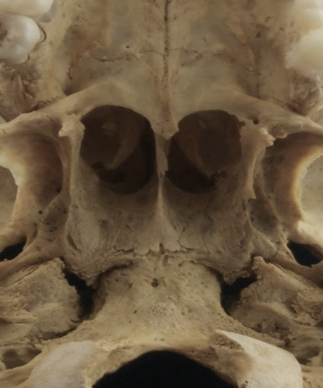
Skull
Skull
Anterior
Lateral
Inferior (base)
Superior (cavity)
Maxilla
Sphenoid bone
Palatine bone
Temporal bone
Vomer
Occipital bone
Vomer
The posterior part of the vomer lies between the medial plates of the sphenoid bones on either side.
It contributes to the inferior and posterior part of the nasal septum.
Choanae
The posterior openings of the nasal passages.
Choanae
Inferior view
(cranial base)
Home
Labels

Slide 26
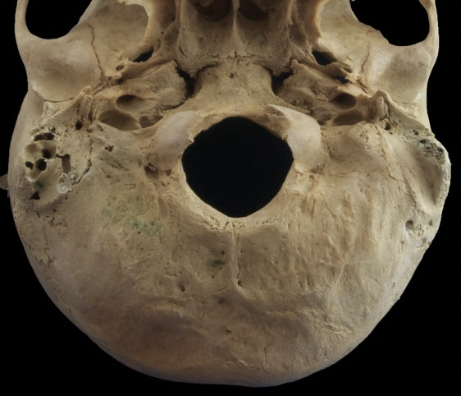
Skull
Skull
Anterior
Lateral
Inferior (base)
Superior (cavity)
Maxilla
Sphenoid bone
Palatine bone
Temporal bone
Vomer
Occipital bone
Occipital bone
Foramen lacerum
An opening bounded by the pterygoid process, petrous part of the temporal and basilar part of the occipital bones.
Transmits the greater petrosal nerve.(not part of the occipital bone)
Jugular foramen
An opening between the petrous part of the temporal bone and the jugular notch of the occipital bone.
Transmits the internal jugular vein, the glossopharyngeal nerve (CN IX), vagus nerve (CN X), and the accessory nerve (CN XI).
Hypoglossal canal
An opening anterior and superior to the condyle.
Transmits the hypoglossal nerve (CN XII).
Occipital condyle
A smooth surface that articulates with the first cervical vertebrae (atlas).
Foramen magnum
A large opening in the anterior and midline part of the occipital bone.
Transmits the medulla of the brainstem, the vertebral vessels, and the spinal roots of the accessory nerve (CN XI).
Foramen lacerum
Basilar part
Jugular foramen
Foramen magnum
Hypoglossal canal
Occipital condyle
Inferior view
(cranial base)
Home
Labels

Slide 27

Skull
Skull
Anterior
Lateral
Inferior (base)
Superior (cavity)
Frontal bone
Frontal bone
Ethmoid bone
Sphenoid bone
Temporal bone
Occipital bone
Orbital plate
Ethmoid bone
Anterior cranial fossa
Foramen cecum
Cribiform plate
Crista galli
Sphenoid bone
Cranial cavity
The cranial cavity can be viewed by removing the top of the skull (calvaria).
The cranial cavity contains the brain, the meninges, the cranial nerves, and the cranial vessels.
It can be divided into three separate fossae.
The anterior fossa is separated from the middle fossa by the lesser wing of the sphenoid bone.
The middle fossa is separated by the posterior fossa by the petrous ridge of the temporal bone.
Each fossa contains several foramina, all of which are important to remember as well as the nerves or vessels that pass through them.
Lesser wing
Optic canal
Foramen rotundum
Greater wing
Foramen ovale
Middle cranial fossa
Foramen spinosum
Foramen lacerum
Temporal bone
Squamous part
Arcuate eminence
Petrous part
Internal acoustic meatus
Parietal bone
Posterior cranial fossa
Occipital bone
Jugular foramen
Hypoglossal canal
Foramen magnum
Superior view
(cranial cavity)
Home
No labels

Slide 28
Skull
Skull
Anterior
Lateral
Inferior (base)
Superior (cavity)
Frontal bone
Ethmoid bone
Sphenoid bone
Temporal bone
Occipital bone
Superior view
(cranial cavity)
Home
Labels

Slide 29
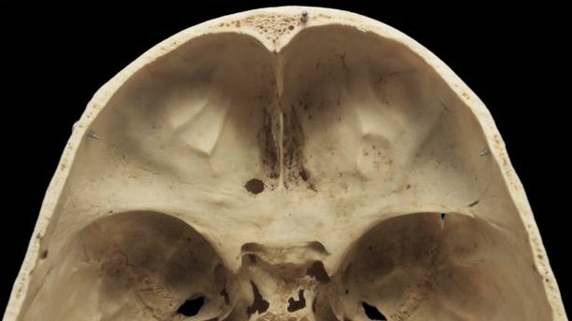
Skull
Skull
Anterior
Lateral
Inferior (base)
Superior (cavity)
Frontal bone
Ethmoid bone
Sphenoid bone
Temporal bone
Occipital bone
Groove for anterior meningeal vessels
Groove for superior sagittal sinus
Orbital plate
Frontal bone
Orbital plate
The superior surface of the orbit.
Superior view
(cranial cavity)
Home
Labels

Slide 30
Skull
Skull
Anterior
Lateral
Inferior (base)
Superior (cavity)
Frontal bone
Ethmoid bone
Sphenoid bone
Temporal bone
Occipital bone
Foramen cecum
Crista galli
Cribiform plate
Ethmoid bone
Cribiform plate
A perforated plate of bone that lies between the two orbital plates of the frontal bone.
Contains foramina that transmit the olfactory nerves (CN I).
Crista galli
A crest of bone that projects superiorly from the midline.
The attachment point for the falx cerebri.
Falx cerebri – a crescent shaped sheet of meningeal dura mater that contains the superior sagittal sinus.
Foramen cecum
An opening between the ethmoid and frontal bones that transmits an emissary vein which bridges the nasal cavity and the superior sagittal sinus.
Superior view
(cranial cavity)
Home
Labels

Slide 31
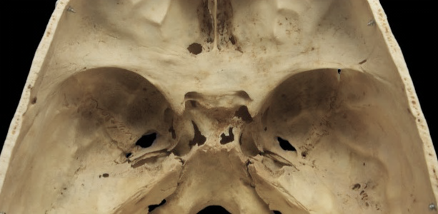
Skull
Skull
Anterior
Lateral
Inferior (base)
Superior (cavity)
Frontal bone
Ethmoid bone
Sphenoid bone
Temporal bone
Occipital bone
Sella turcica
Optic canal
Lesser wing
Foramen rotundum
Sphenoid bone
Sella turcica
A depression that contains the pituitary gland and part of the cavernous sinus.
Optic canal
An opening that projects anteriorly to the orbit.
Transmits the optic nerve (CN II) and the ophthalmic artery.
Foramen rotundum
An opening in the medial part of the greater wing.
Transmits the maxillary nerve (V₂)
Foramen ovale
An opening posterior to the foramen rotundum.
Transmits the mandibular nerve (V₃), the accessory meningeal artery, and the lesser petrosal nerve.
Foramen spinosum
A small opening just posterior to the foramen ovale.
Transmits the middle meningeal artery and the meningeal branch of the mandibular nerve
Greater wing
Foramen ovale
Foramen spinosum
Foramen lacerum
Superior view
(cranial cavity)
Home
Labels

Slide 32
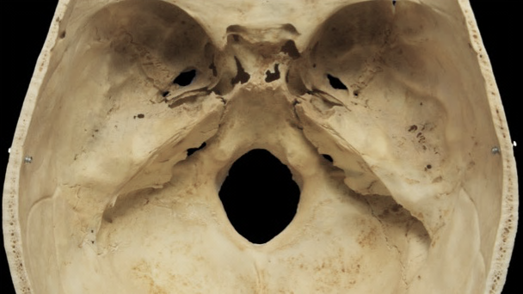
Skull
Skull
Anterior
Lateral
Inferior (base)
Superior (cavity)
Frontal bone
Ethmoid bone
Sphenoid bone
Temporal bone
Occipital bone
Petrous part
Internal acoustic meatus
Squamous part
Arcuate eminence
Temporal bone
Petrous part
An elevated portion of bone that resembles a mountain.
The petrous ridge separates the middle cranial fossa from the posterior cranial fossa.
Petrous = rock like
Squamous part
The flattened part of bone that extends superiorly towards the lateral part of the skull.
Internal acoustic meatus
An opening in the medial side of the petrous part just superior and anterior to the jugular foramen.
Transmits the facial nerve (CN VII), the vestibulocochlear nerve (CN VIII), and the labyrinthine artery.
Arcuate eminence
A rounded elevation on the superior aspect of the petrous part.
Indicates the position of the underlying anterior semicircular canal of inner ear.
Petrous ridge
Superior view
(cranial cavity)
Home
Labels

Slide 33
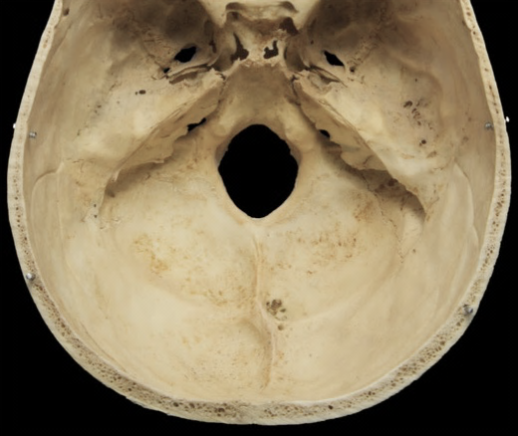
Skull
Skull
Anterior
Lateral
Inferior (base)
Superior (cavity)
Frontal bone
Ethmoid bone
Sphenoid bone
Temporal bone
Occipital bone
Occipital bone
Jugular foramen
A large opening in the created by the joining of the occipital bone and the petrous part of the temporal bone.
Transmits the internal jugular vein, the glossopharyngeal nerve (CN IX), the vagus nerve (CN X), the accessory nerve (CN XI), and the posterior meningeal artery.
Foramen magnum
A large opening in the anterior and midline part of the occipital bone.
Transmits the medulla of the brainstem, the vertebral vessels, and the spinal roots of the accessory nerve (CN XI).
Hypoglossal canal
An opening just medial and inferior to the jugular foramen and superior to the margins of the foramen magnum.
Transmits the hypoglossal nerve (CN XII).
Jugular foramen
Foramen magnum
Hypoglossal canal
Superior view
(cranial cavity)
Home
Labels

